Slide 1



ROADMAP
generator
CAREERTRIX
Presented by TEAM-ඞ

Slide 2



agenda
1
5
Careertrix-Breif
Features
2
6
Origin
Future of Carrertrix
3
7
Team Members
Tech-Stack
4
Working

Slide 3

welcome!
Thank you for taking interest in our website, CareerTix!
We’re thrilled to share this exciting milestone with you—our very first venture into the digital space. CareerTix is designed to inspire and support individuals like you on their career journey, and we couldn’t be more grateful to have your attention today.
As you go through this presentation, we invite you to share your thoughts, feedback, and ideas with us. Your input is invaluable in helping us grow and serve you better.
Thank you once again for joining us on this journey. We’re excited to make this experience meaningful and enjoyable for you!
Let’s begin!

Slide 4
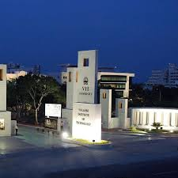
Brief-about us
Our Origin
CareerTix was born in just 2 days during a hackathon at VIT Vellore, crafted by a team of 6 passionate students.
The website is designed to help you create personalized career roadmaps. By analyzing your skills and dream job, it generates a step-by-step guide to acquire the skills needed for your career goals.
We’re proud to share that CareerTix earned 5th place among 650+ participants in the IEEE CS VIT Hackathon!

Slide 5



Meet the team
Find us @LinkedIn
Aman
Ashwin
Ojas
Sivanesh
Thiru
Vishnu

Slide 6

How CareerTix Works
1
Step 1
2
Step 2
Sign in and provide your details—current job, experience, and most importantly, your technical and soft skills.
Input skills manually or upload your resume, and our resume parser extracts them for you.
Access the homepage with features like trending jobs and networking (future improvements). Enter your goal job, and our ML algorithms generate a personalized roadmap:
Existing skills are marked as completed.
Required skills to achieve your dream job are highlighted for you to work on.

Slide 7
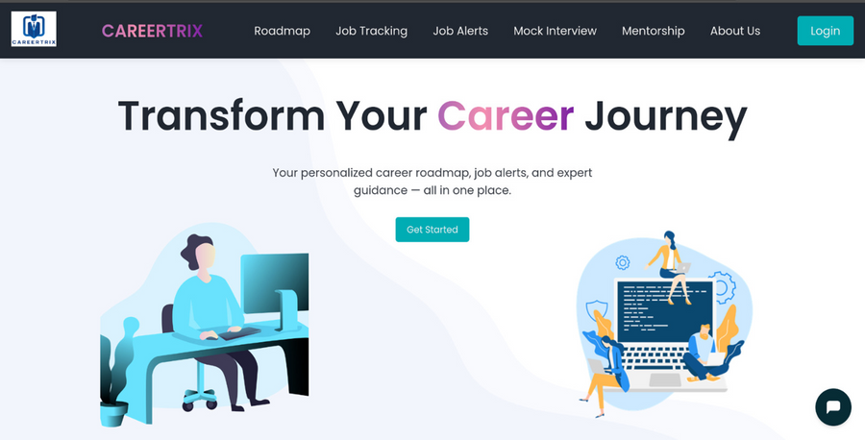
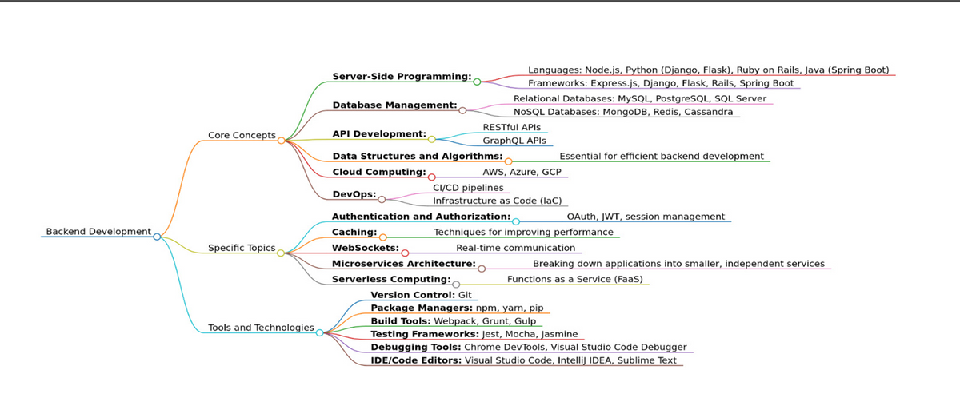
JOB ANALYZER
ROADMAP
Our ML model analyzes the skills and requirements for various jobs using the Gemini API, ensuring you get accurate, up-to-date job insights.
It processes current job trends and tailors recommendations based on your skills, creating a clear view of the roles that suit you best.
By analyzing your current skills and career goals, our ML algorithm creates a customized roadmap to help you bridge the gap.
Our user experince is the real highlight, providing an intuitive, smooth, and user-friendly experience, making it easy to navigate and track your progress.

Slide 8
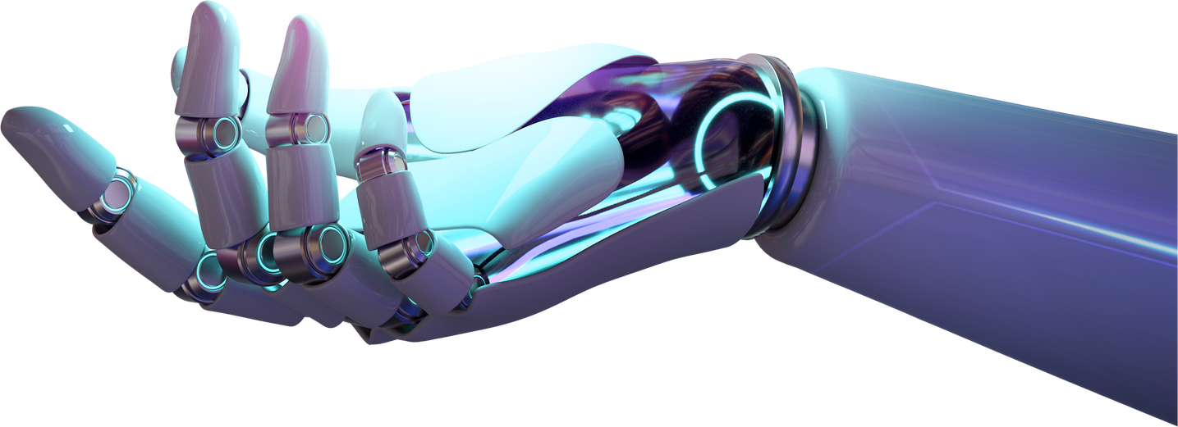
future versions
All About it
AI Mock Interviews: Prepare for real-life interviews with AI-powered simulations.
Resume Builder: Create standout resumes tailored to your career goals.
Job Networking: Connect with professionals and recruiters for valuable opportunities.
Resume Parser & Database Development: Enhance accuracy and reduce reliance on external APIs by building an in-house system.
We’re committed to evolving CareerTix, continuously adding features to support your career journey and make the experience even more valuable.

Slide 9

TECH STACK
This robust tech stack ensures a seamless, efficient, and user-friendly experience for our users.
Frontend
Backend
Machine Learning
HTML, CSS, and JavaScript for building a responsive and engaging user interface.
Frameworks: Django, Flask
Language: Python
Natural Language Processing: nltk
Libraries- Node, Markmap, Allauth

Slide 10
Thank
you!
For visiting CAREERTRIX
www.careertrix.com

